Slide 1
On the Use of the Moment-Matching Technique for Pricing and Hedging Multi-Asset Spread Options
Tommaso Pellegrino, joint work with Piergiacomo Sabino
E.ON Global Commodities – (CRM) Risk Methods Team
October 10th , 2013
All parameters and values here do not reflect any E.ON view and their calibration is not the focus of this paper.

Slide 2
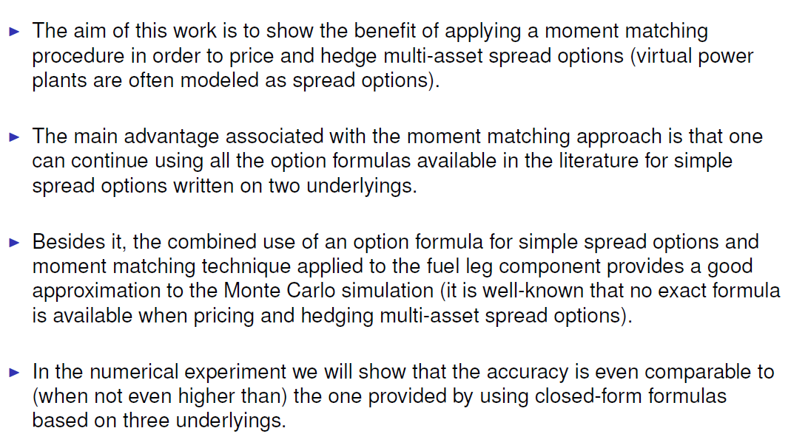
Introduction and Motivation

Slide 3
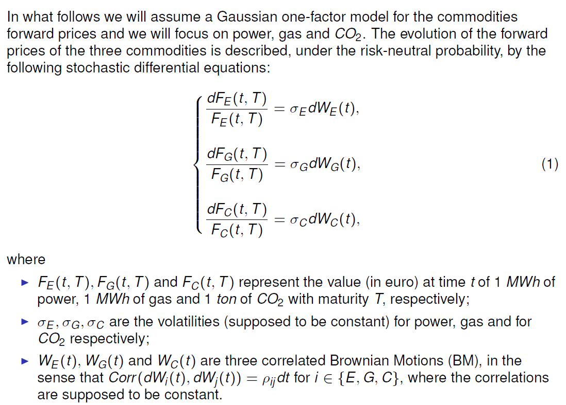
Assumptions and Notations

Slide 4
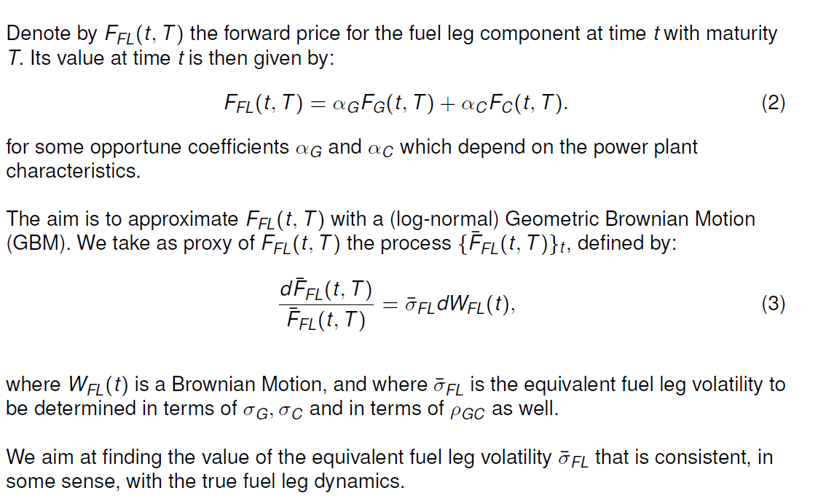
The Log-Normal Proxy Fuel Leg

Slide 5
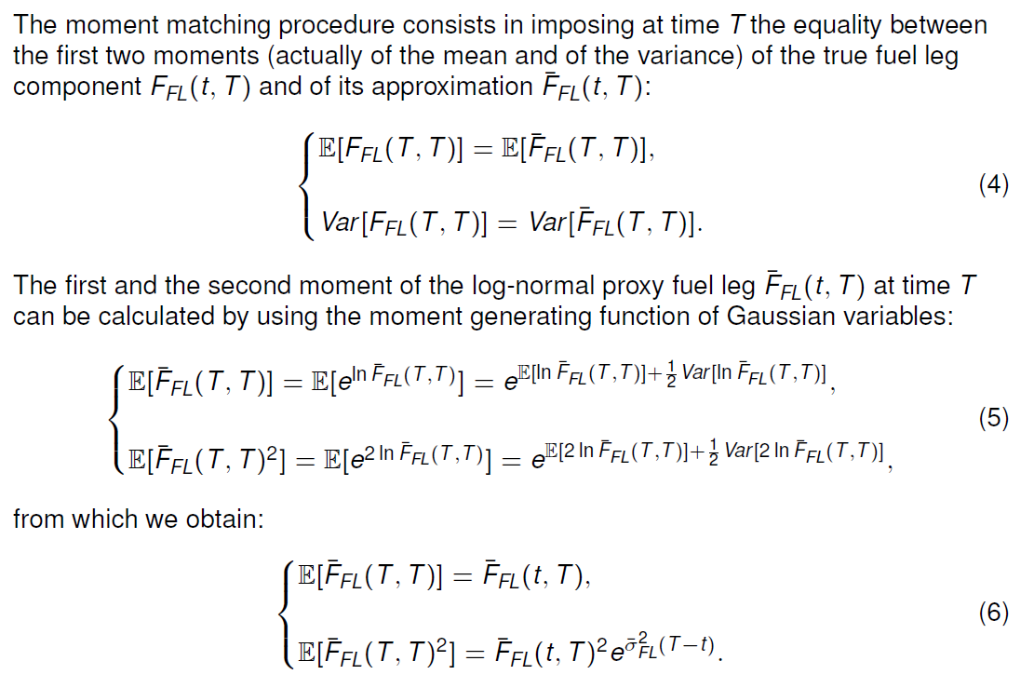

The Moment-Matching Technique (1)

Slide 6
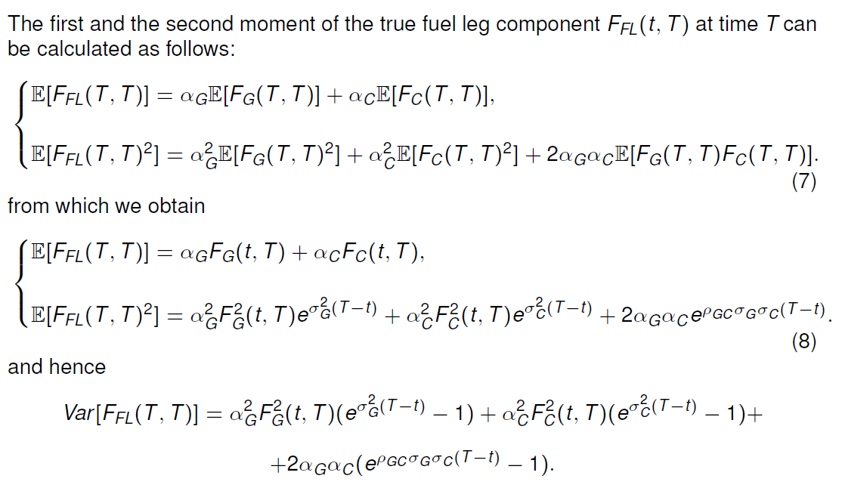
The Moment-Matching Technique (2)

Slide 7
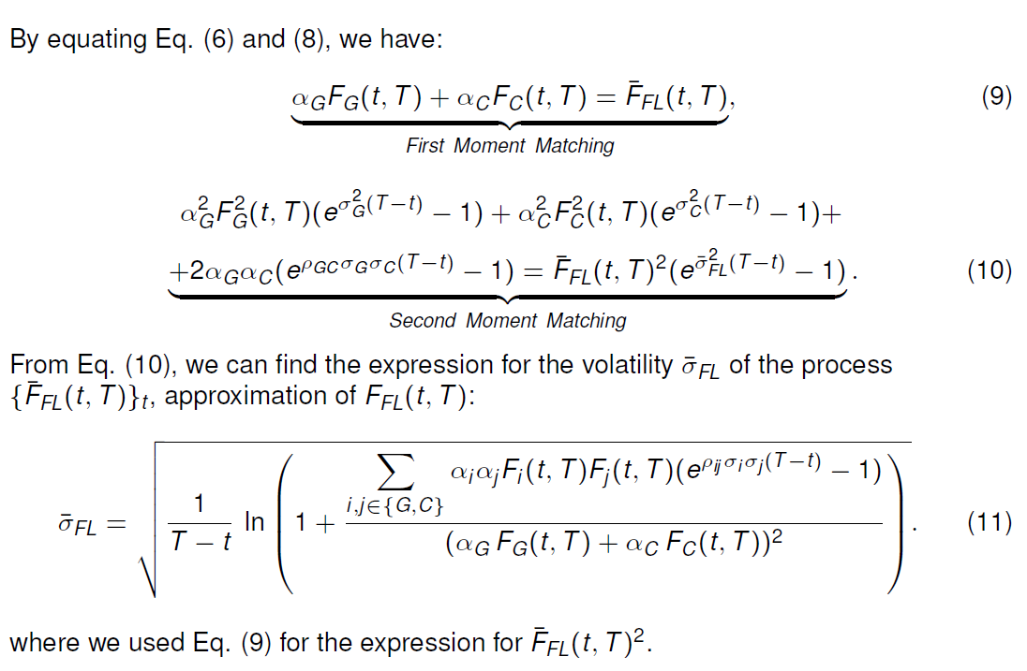
The Equivalent Fuel Leg Volatility

Slide 8
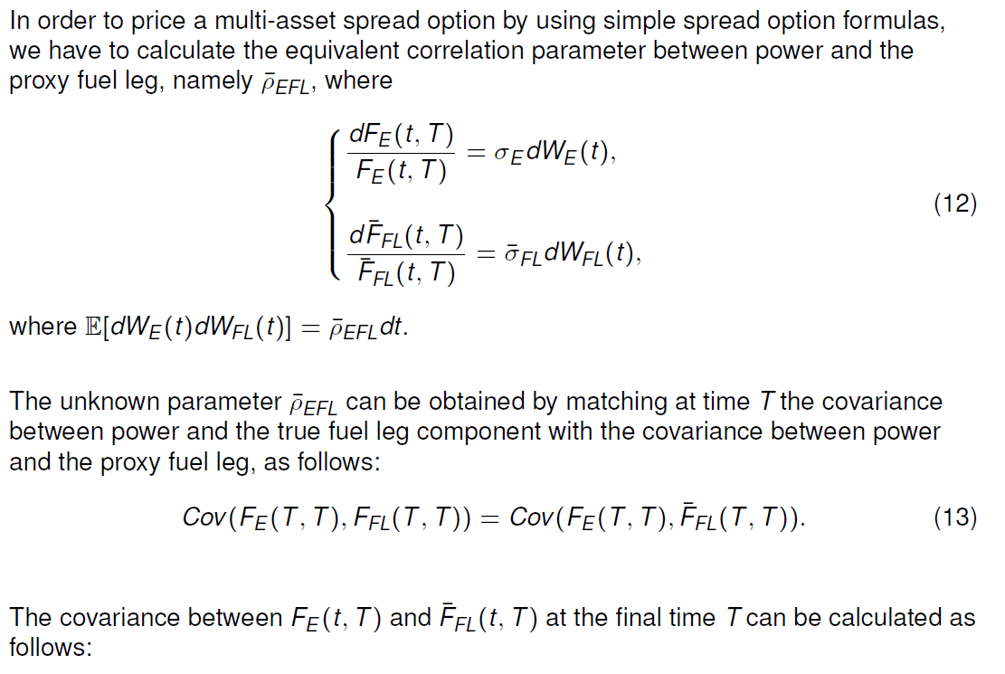
The Equivalent Correlation Parameter (1)

Slide 9
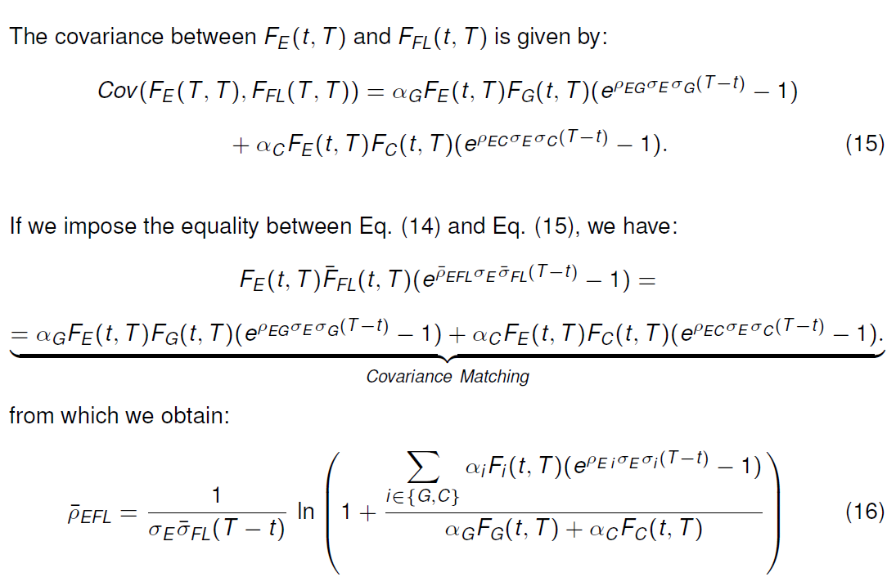
The Equivalent Correlation Parameter (2)

Slide 10
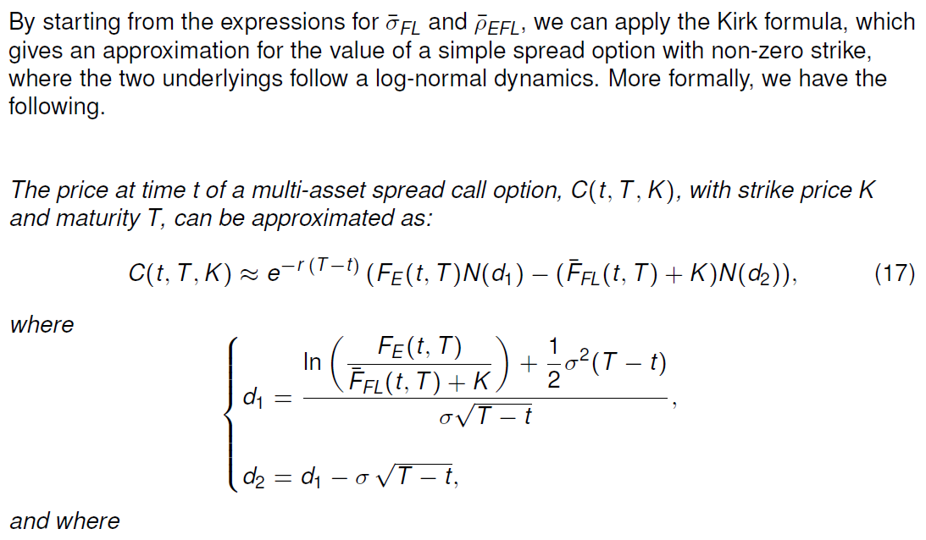
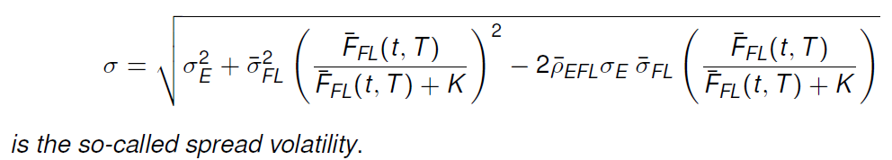
A First Application: Kirk Formula with Moment Matching

Slide 11
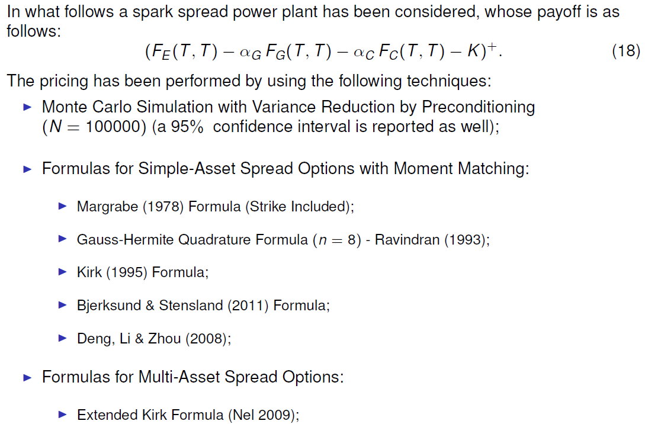
Numerical Example: Application to a Strip of Monthly Clean Spark Spread Options

Slide 12
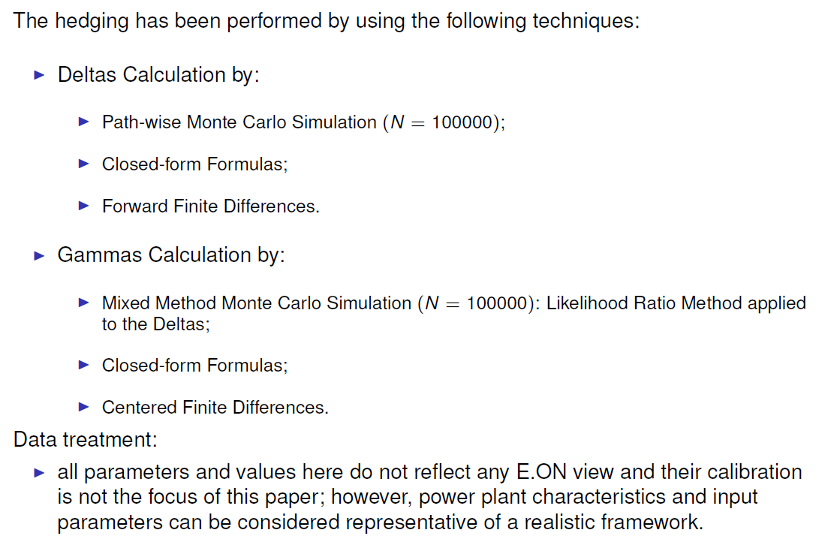
Hedging Parameters Calculation

Slide 13
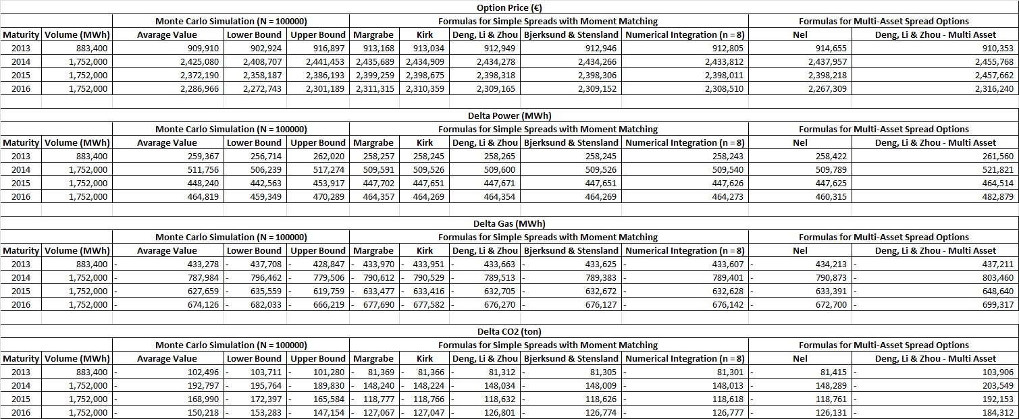
Option Value and Deltas
All parameters and values here do not reflect any E.ON view and their calibration is not the focus of this paper.

Slide 14
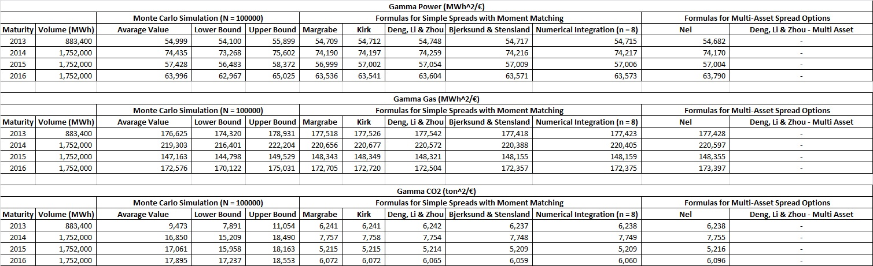
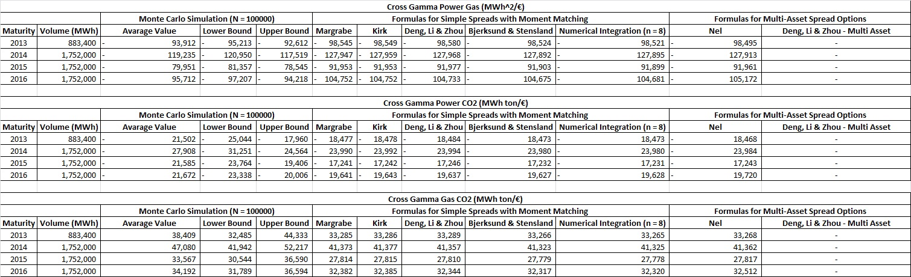
Gammas and Cross-Gammas
All parameters and values here do not reflect any E.ON view and their calibration is not the focus of this paper.

Slide 15
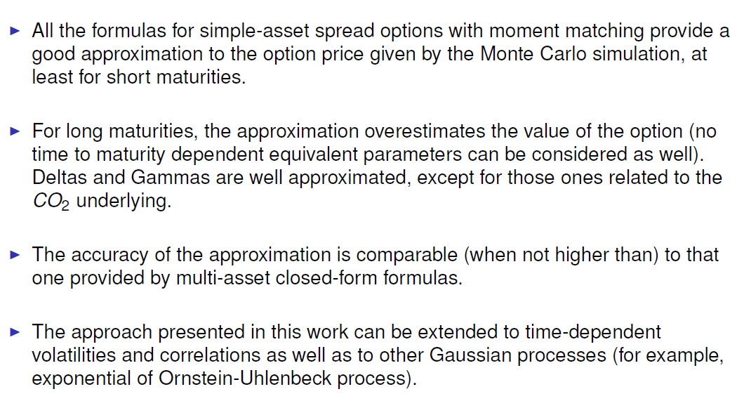
Conclusions and Future Studies

Slide 16
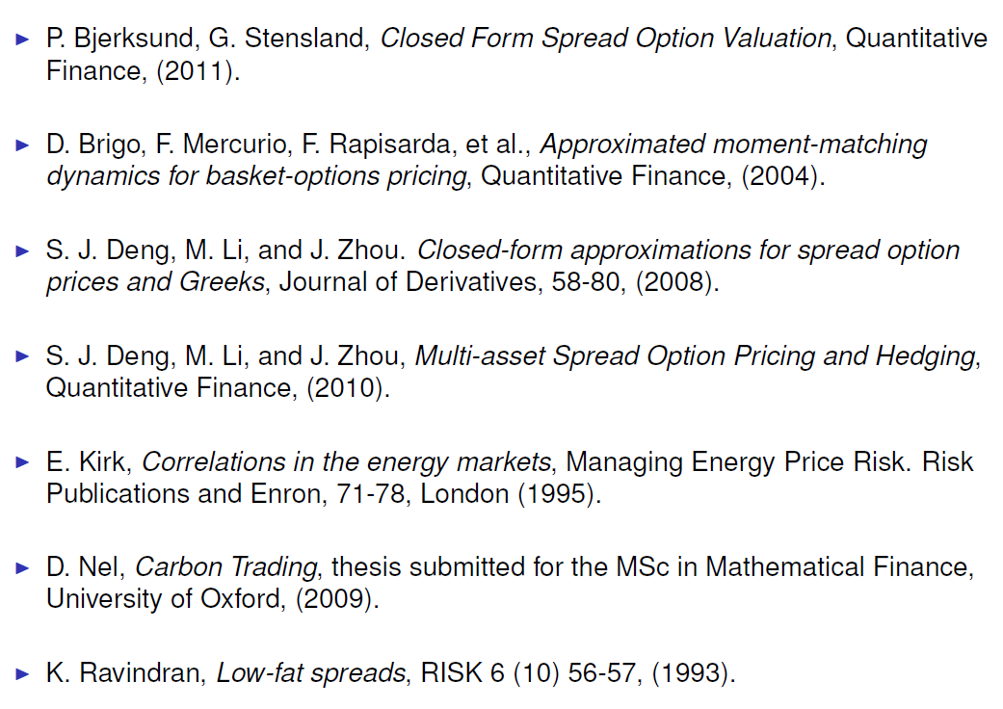
Bibliography

