Slide 1
Enhancing Least Squares Monte Carlo with Diffusion Bridges: an Application to Virtual Hydro Power Plants
Piergiacomo Sabino, joint work with Tommaso Pellegrino
E.ON Global Commodities – (CRM) Risk Methods Team
October 9th, 2013
All parameters and values here do not reflect any E.ON view and their calibration in not the focus of this paper

Slide 2
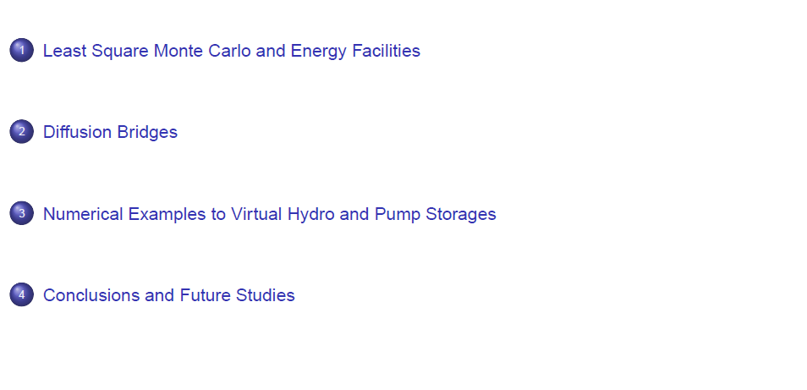
Contents

Slide 3
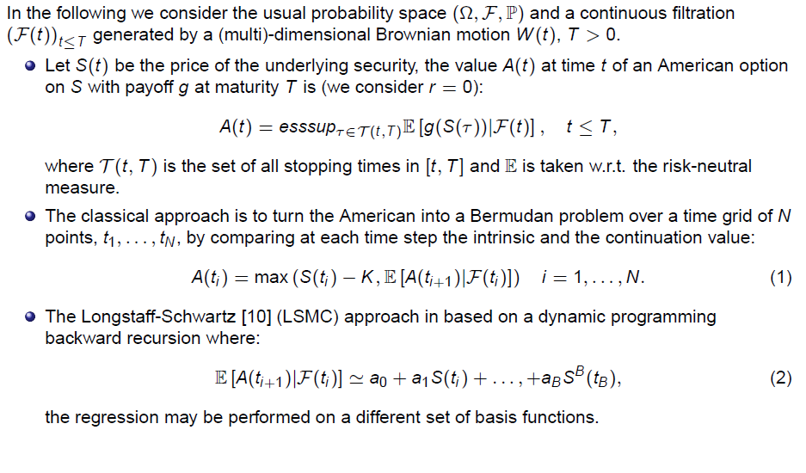
Original LSMC as per Longstaff-Schwartz

Slide 4
LSMC for Energy Facilities

Slide 5
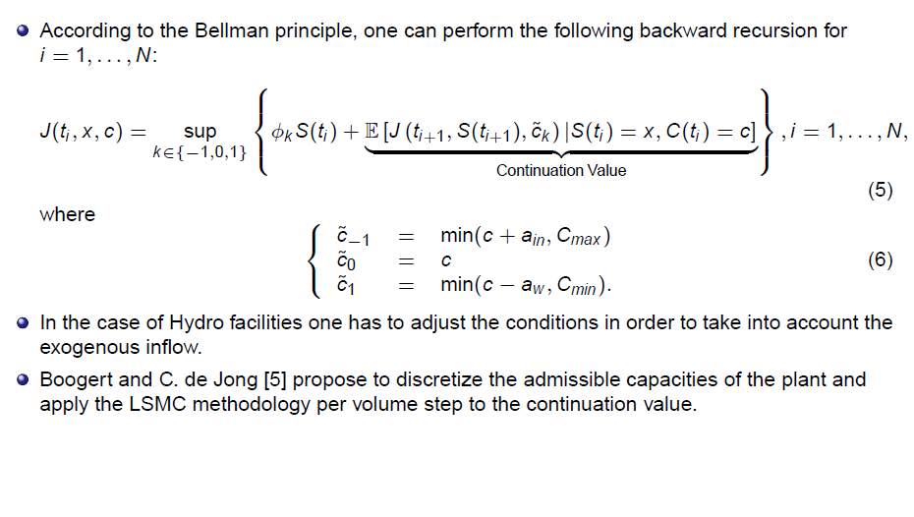
LSMC for Energy Facilities

Slide 6
LSMC and Path Generation

Slide 7
Brownian Bridge Construction

Slide 8
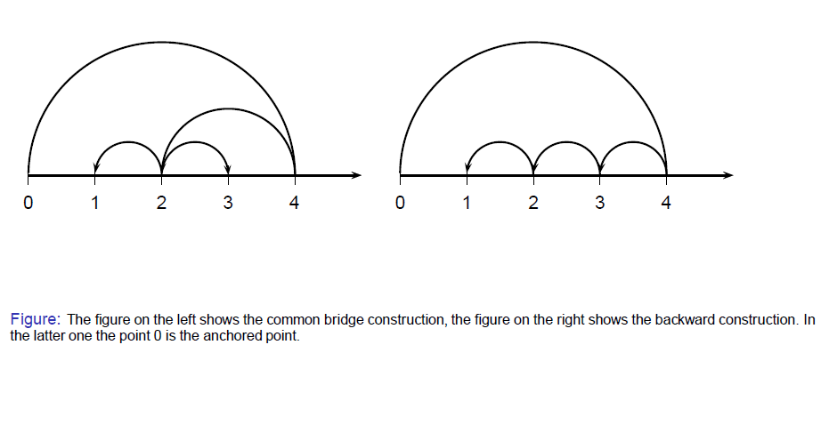
Brownian Bridge Construction

Slide 9
Brownian Bridge Construction

Slide 10
Ornstein-Uhlenbeck Bridge

Slide 11
Time reversal Ito Diffusions vs Exact Simulation

Slide 12
Numerical Examples: Settings

Slide 13
A Simple American (European) Call
All parameters and values here do not reflect any E.ON view and their calibration in not the focus of this paper

Slide 14
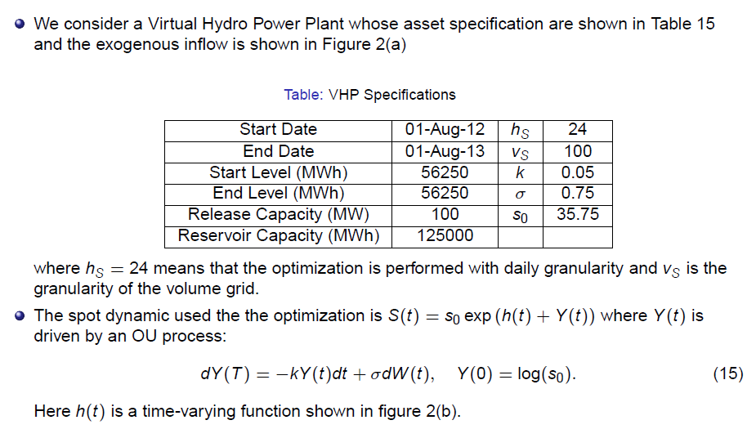
Application to VHP and Backward Recursion
All parameters and values here do not reflect any E.ON view and their calibration in not the focus of this paper

Slide 15
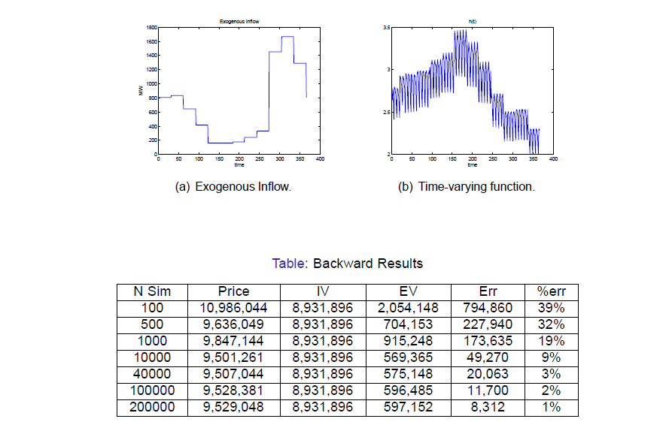
Application to VHP and Backward Recursion
All parameters and values here do not reflect any E.ON view and their calibration in not the focus of this paper

Slide 16
Application to VHP and Backward Recursion

Slide 17
Application to VHP and Forward Recursion
All parameters and values here do not reflect any E.ON view and their calibration in not the focus of this paper

Slide 18
Application to VHP and Forward Recursion

Slide 19
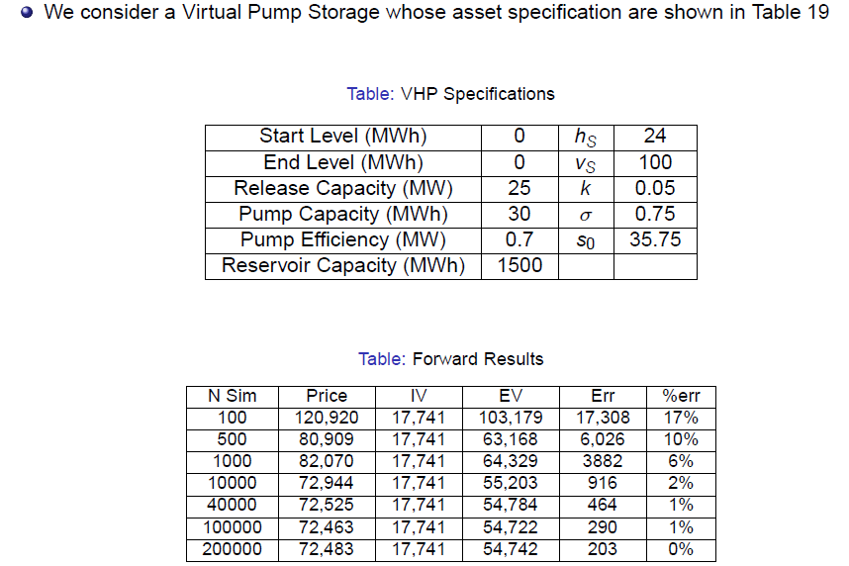
Application to VPS
All parameters and values here do not reflect any E.ON view and their calibration in not the focus of this paper

Slide 20
Conclusions and Future Studies

Slide 21
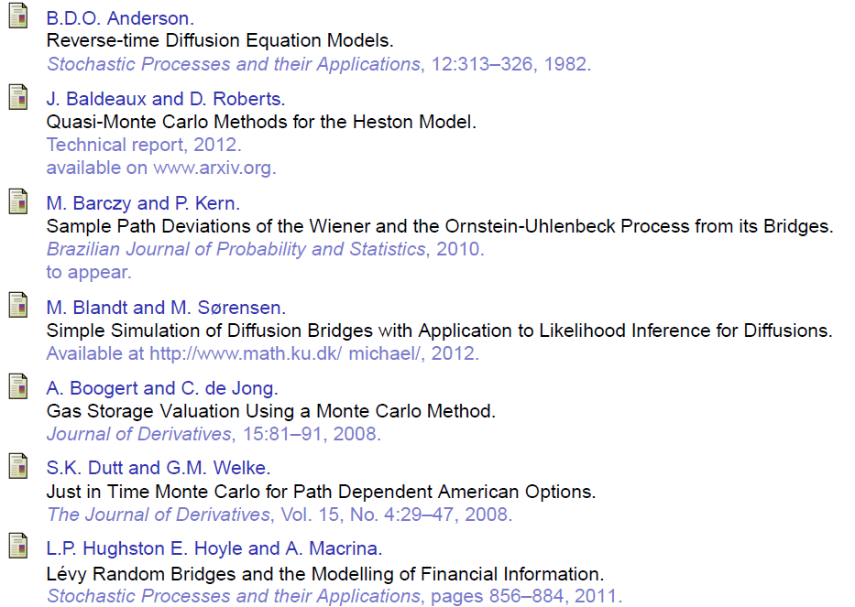

Slide 22
